Slide 1
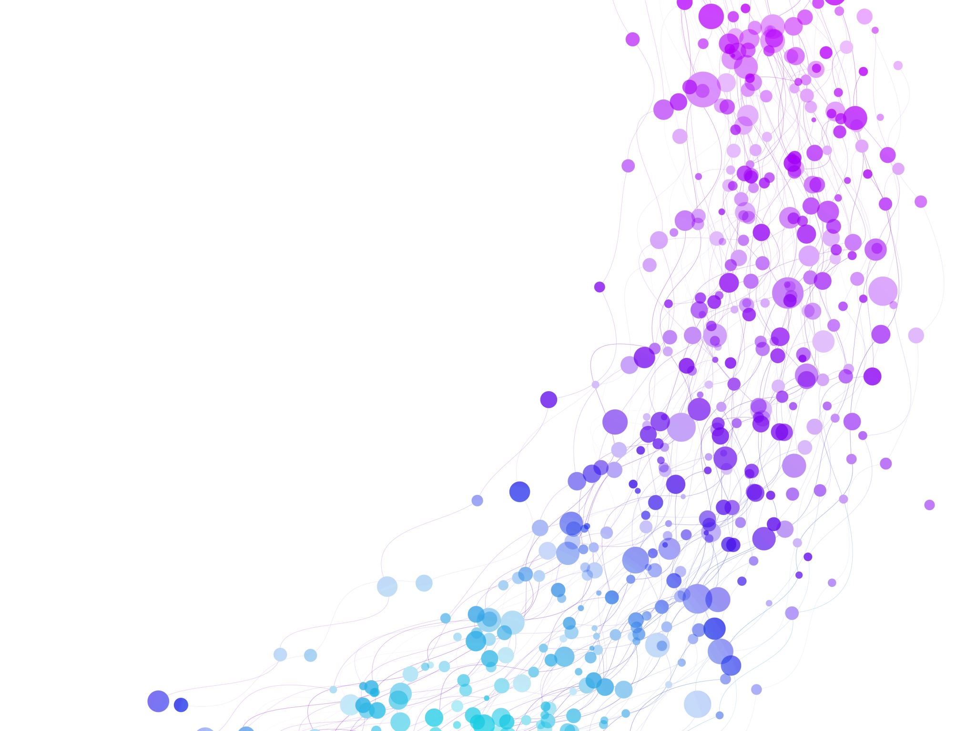


TF-IDF Term Frequency- Inverse Document Frequency Session No.: 11 Course Name: NLP Instructor Name: Mr. Amit Yadav

Slide 2
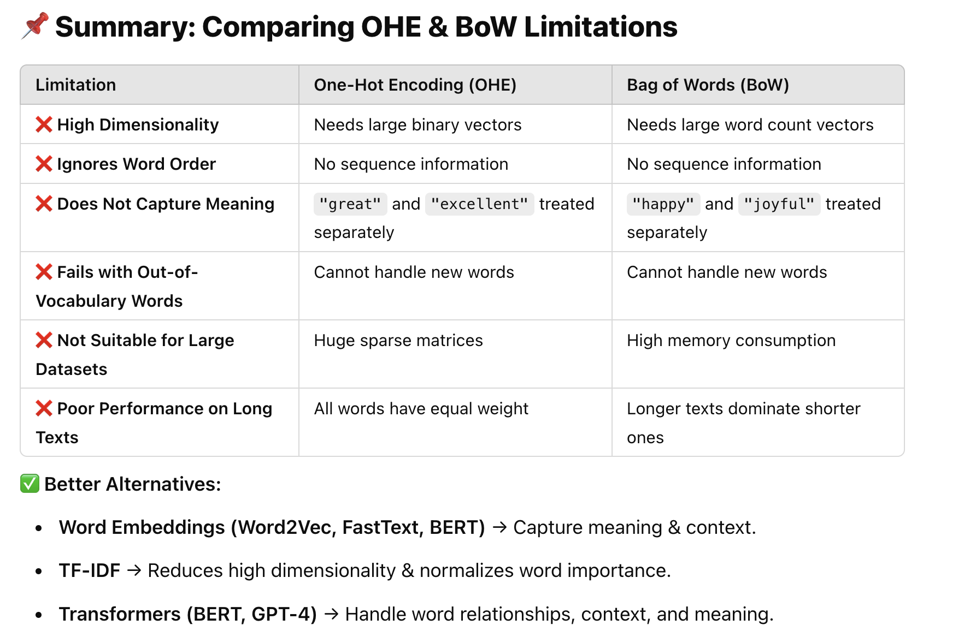
Insert Review of the key concepts of session no. 10

Slide 3
Reflect on the responses of post session activity

Slide 4

💡 Imagine you are building a search engine for movie reviews. A user searches for "amazing action movie", and you need to rank the following reviews:
1️⃣ "This action movie is amazing and full of thrill." 2️⃣ "Amazing cinematography, but the action scenes were average." 3️⃣ "The movie had action sequences, but it was not amazing."
📌 How do you decide which review is the most relevant?

Slide 5


Ask Questions
✅ Do you just count the number of times words like "amazing" and "action" appear? ✅ What if a common word like "movie" appears in every review—should it affect the ranking? ✅ Should rare words be given more weight than common words?
💡 TF-IDF (Term Frequency-Inverse Document Frequency) is a statistical measure that evaluates how important a word is to a document within a collection (corpus) of documents.

Slide 6
At the end of this session students will be able to
Learning Outcome 1:
Understand TF-IDF Concept
Learning Outcome 2:
Apply TF-IDF to Text Data and analyze the Role of TF-IDF in Search Ranking & Information Retrieval

Slide 7
Session Outline
1 Introduction of the title
2 IDF
3 Activity 1
4 TF
5 Activity 2

Slide 8
IDF
IDF remains the same for a word across all reviews because IDF is calculated at the corpus level, not at the individual document level.
Why Should We Reduce the Impact of Common Words in Text Analysis?

Slide 9

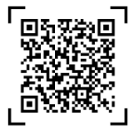
Learning Activity 1
We have 10,000 reviews, and the following words appear in the dataset:
"the" appears in all 10,000 reviews.
"food" appears in 5,000 reviews.
"good" appears in 5,000 reviews.
"bad" appears in 5,000 reviews.
"terrible" appears in only 1 review.
Question1. What weight should we assign to “the” since it appears in all reviews? HInt: Common words like "the" add no meaning to sentiment analysis. If we assign equal importance to every word, words like "the" will dominate the analysis.
Introduce a formula to downweight frequent words and boost rare but meaningful words. total number of reviews where “the” is present is 10k, and total reviews are 10k. Make sure "terrible" gets a higher weight than "food" or "bad"?

Slide 10
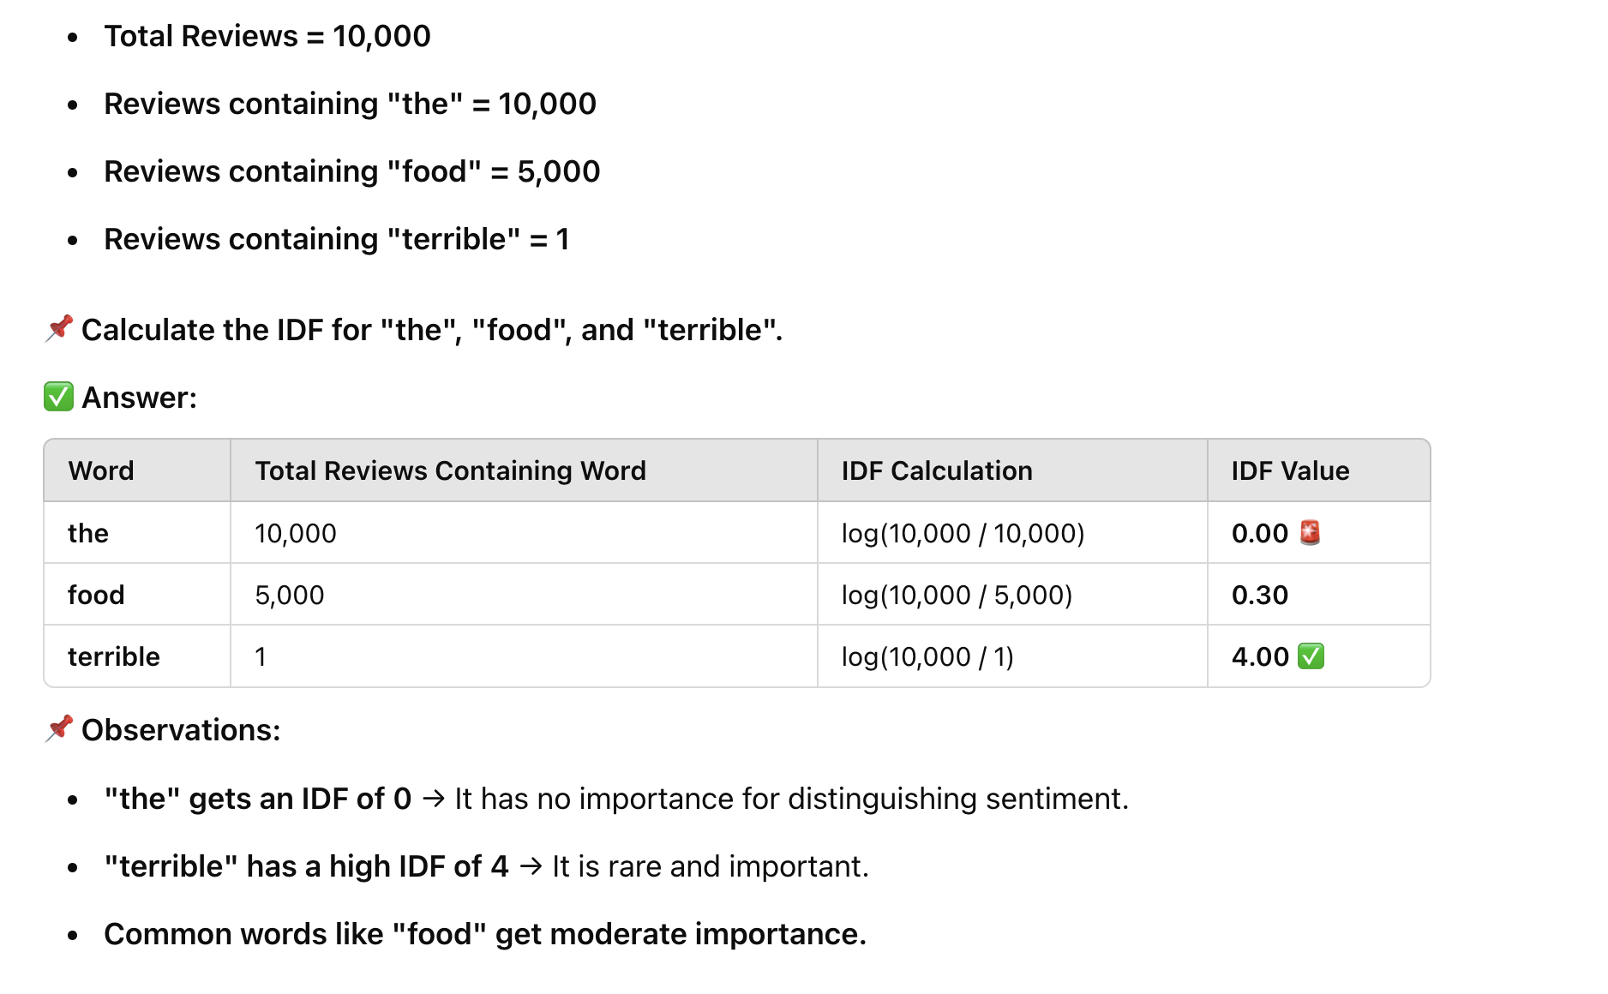
Reflection- Learning
Activity 1

Slide 11
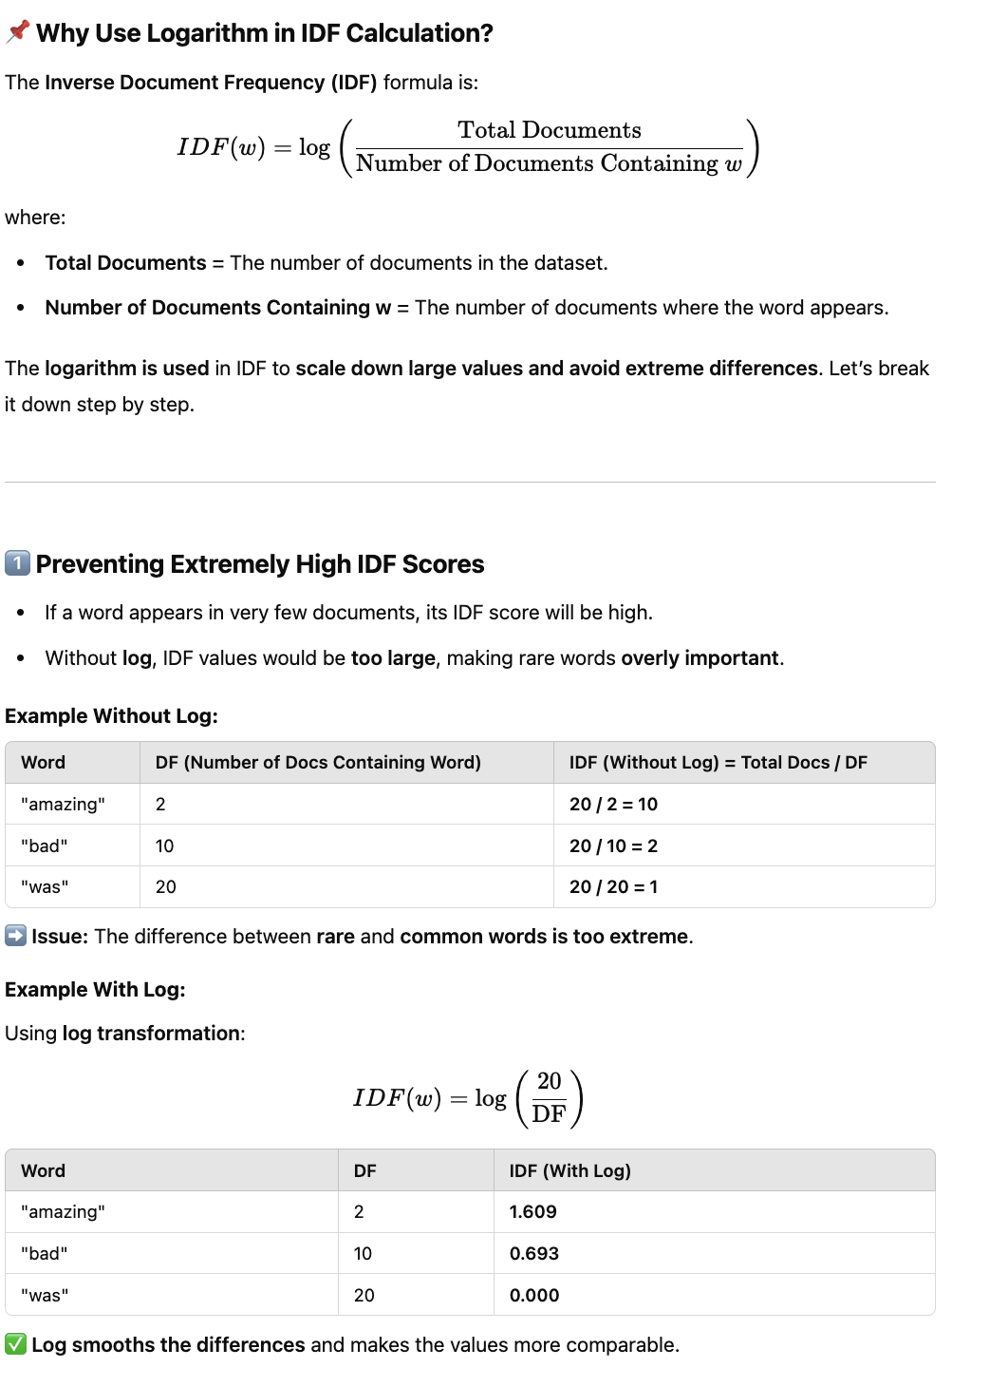

Slide 12
Term Frequency (TF)?
📌 Imagine Two Reviews About a Product:
1️⃣ Short Review: "The phone is excellent." (Total words = 4) ✅ "phone" appears 1 time → TF(phone) = 1
2️⃣ Long Review: "The phone is excellent. The phone is very fast and smooth. I love this phone!" (Total words = 14) ✅ "phone" appears 3 times → TF(phone) = 3
🚨 Issue:
The second review has a higher raw TF score (3 vs. 1) just because it is longer.
Longer reviews will always dominate shorter ones, even if both mention the same word.
This is unfair! We need a way to normalize term frequency.
We divide TF (Term Frequency) by the total number of words in a document to normalize word frequency so that longer documents do not unfairly dominate the scores.

Slide 13

Learning Activity 2
Activity encouraging:
Mind cognitive skills.
Mental Analytical skills
Peer Discussions
Easy understanding of concept

Slide 14
Reflection- Learning Activity 2

Slide 15
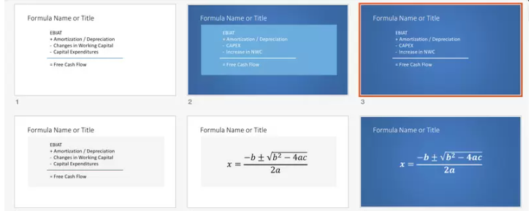
Summary

Slide 16
Ensure attainment of LOs in alignment to the learning activities: outcomes (1-2)
Outcome 1:
Outcome 2:

Slide 17
Information to next topic of the course

Slide 18

Review and Reflection from students

